Slide 1

Higher-order functions
map and app

Slide 2
The order of a function
The order of a function is defined by the following induction:
Basis: A function is “first-order” if its arguments and result are all “data” (i.e., non-function) values.
Induction: A function is of order one more (e.g., 2nd order) than the largest of the orders of its arguments and result. Note that there are some functions, like the identity function, that do not get an order by this induction, and are therefore of “infinite order”.
Source: Elements of ML Programming by Jeffrey D. Ullman

Slide 3
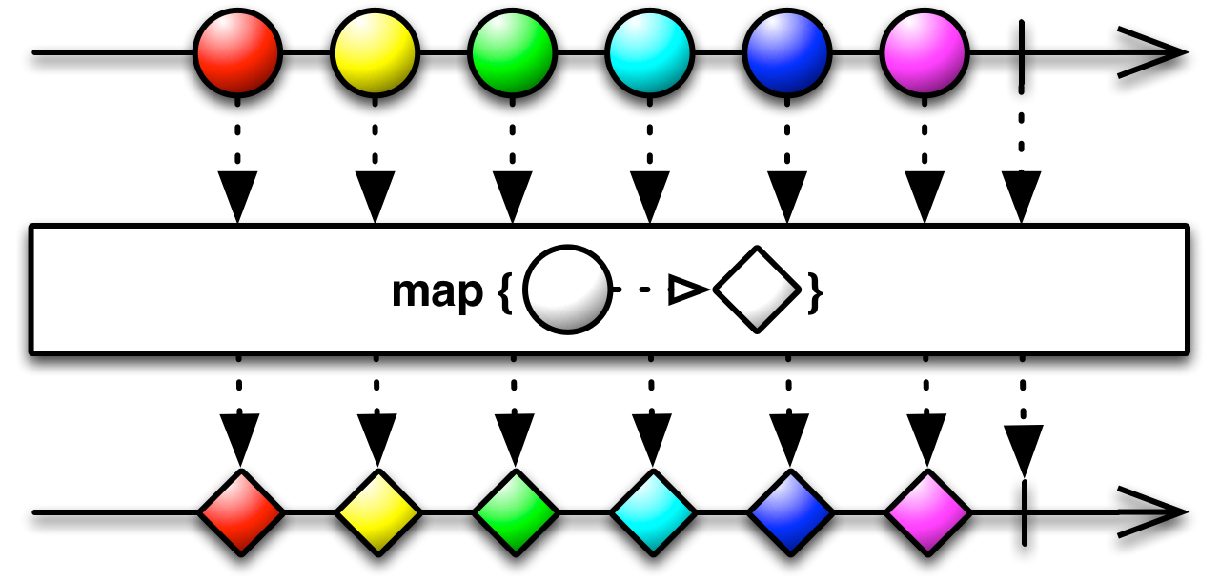

Slide 4
map Implementation
fun map f =
let
fun m nil = nil
| m (x::xs) = f x :: m xs
in
m
end;
*The function map is part of the standard basis.

Slide 5
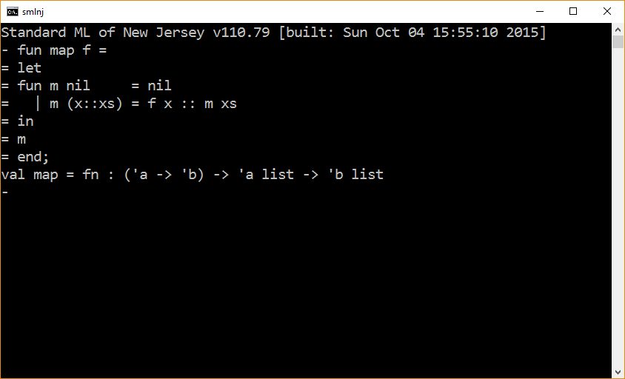

Slide 6
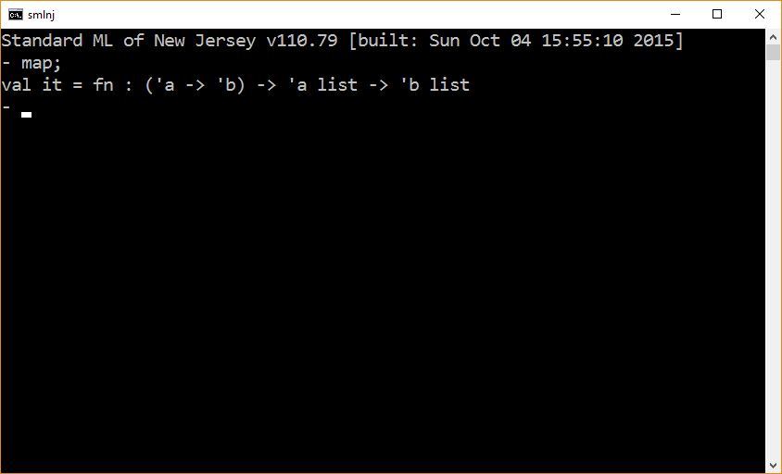
map is part of the standard basis

Slide 7
Map Example 1 – Square list
fun sq x = x*x;
val sqList = map sq;
sqList [1,2,3,4];

Slide 8
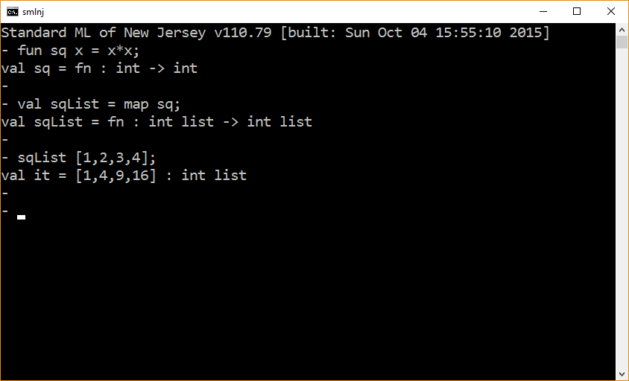

Slide 9
Map Example 2 – Square list list
fun sq x = x*x;
val sqList = map sq;
map sqList [ [1,2], [3,4], [5,6] ];

Slide 10
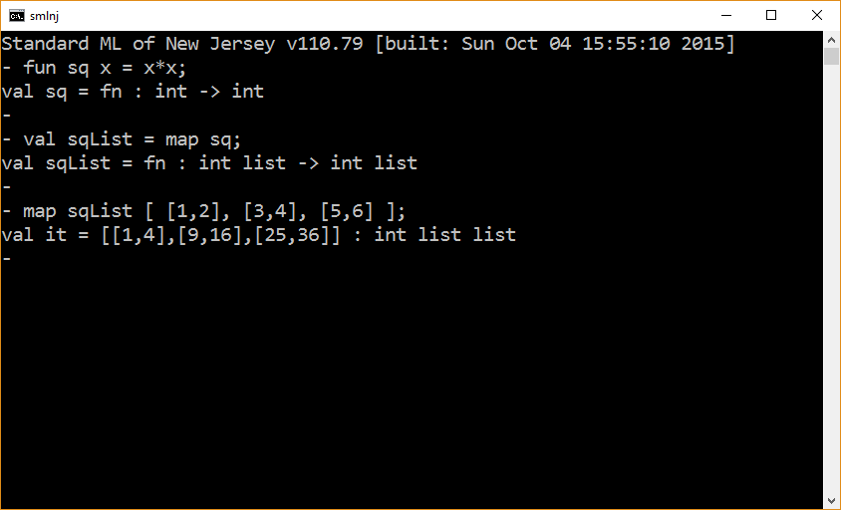

Slide 11
Map Example 3 – Print Int list
fun showInt x = print(Int.toString x ^ “\n”) ;
map showInt [1,2,3,4];

Slide 12
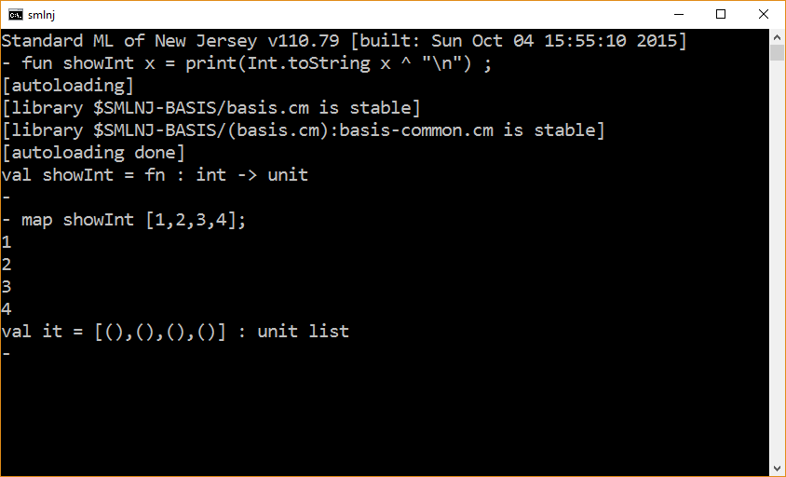

Slide 13
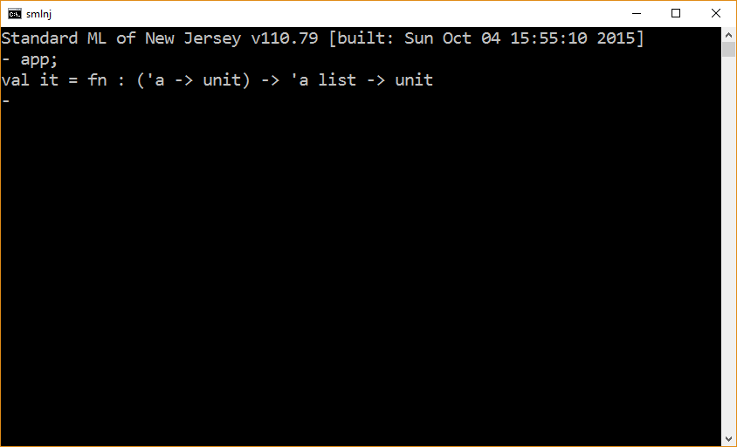
App … Like map

Slide 14
App Example 1 – Print Int list
fun showInt x = print(Int.toString x ^ “\n”) ;
app showInt [1,2,3,4];

Slide 15
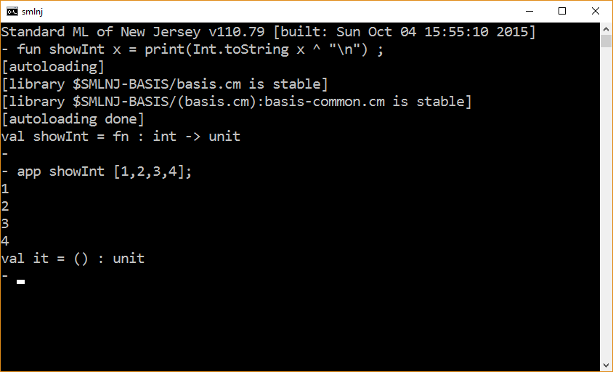

Slide 16
App – Implementation 1
fun app f =
let
fun process nil = ()
| process (x::xs) = (f x ; process xs)
in
process
end;

Slide 17
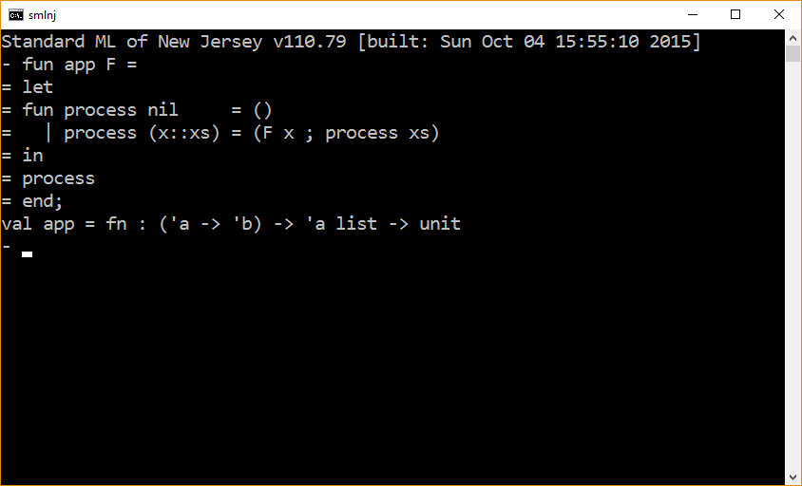

Slide 18
App Example 1
fun app f =
let
fun process nil = ()
| process (x::xs) = (f x ; process xs)
in
process
end;
fun showInt x = print(Int.toString x ^ “\n”) ;
app showInt [1,2,3,4];

Slide 19
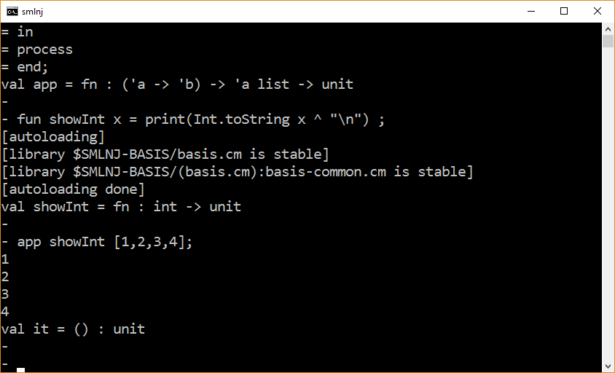

Slide 20
App – Implementation 2
fun app f =
let
fun process nil = ()
| process (x::xs) = (f x : unit ; process xs)
in
process
end;

Slide 21
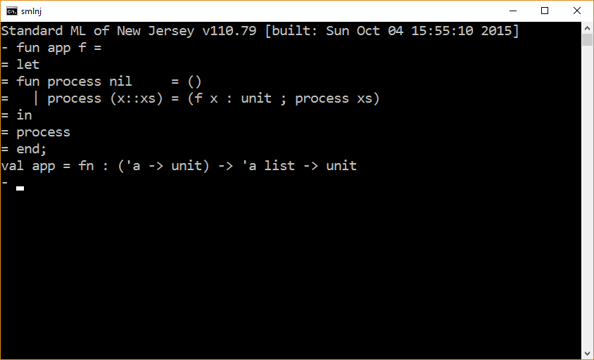

Slide 22
The end

